Slide 1
Prework

Slide 2
Write this down:

Slide 3
Nonvisitors
Visitors
Leads
Clients
Repeat clients

Slide 4
The Smartest Things I Did For Linda

Slide 5
1. Know what pages get visited most
2. Put an opt-in on those pages
3. Make that opt-in better
4. Measure and iterate
5. Ask questions

Slide 6
Know what pages get visited most
www.google.com/analytics

Slide 7
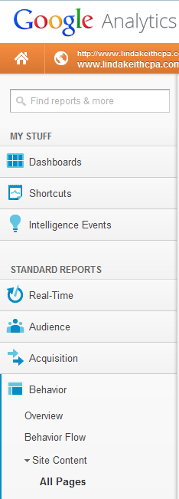

Slide 8
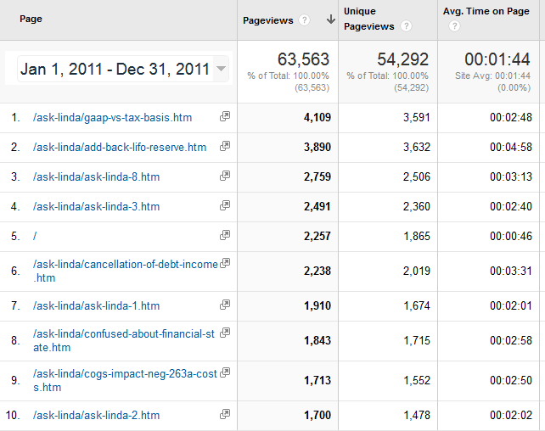

Slide 9
How to install Google Analytics
youtube.com/watch?v=P_l4oc6tbYk

Slide 10
Put an opt-in on those pages

Slide 11
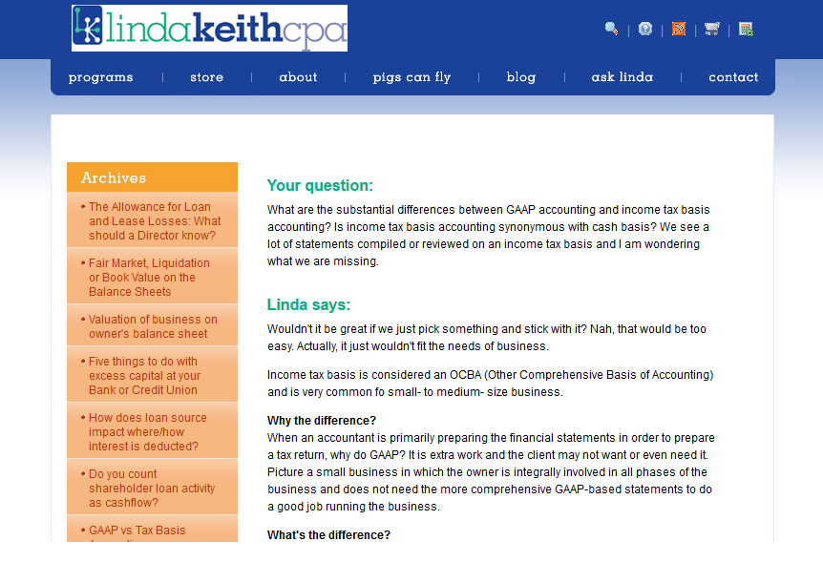
Before

Slide 12
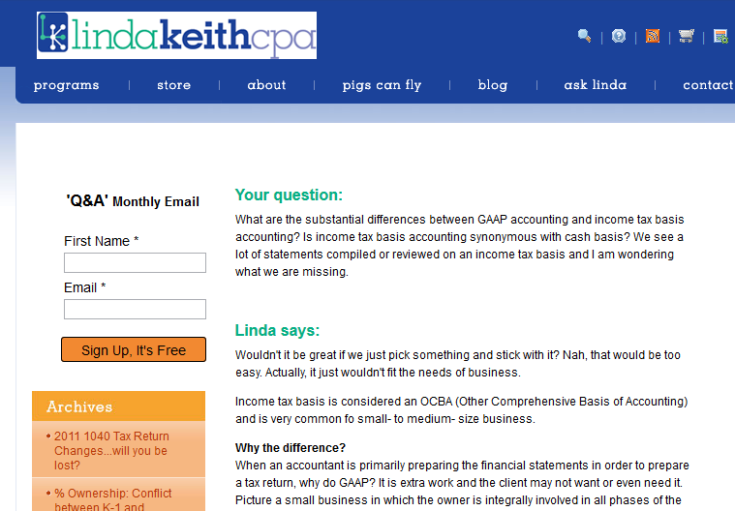
After

Slide 13
Make that opt-in better

Slide 14


Slide 15
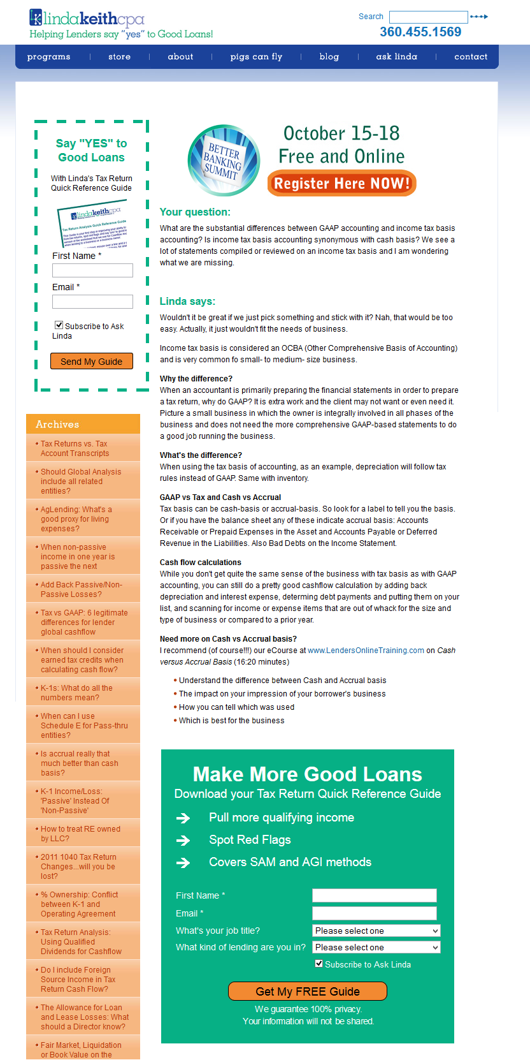

Slide 16
Measure and iterate

Slide 17
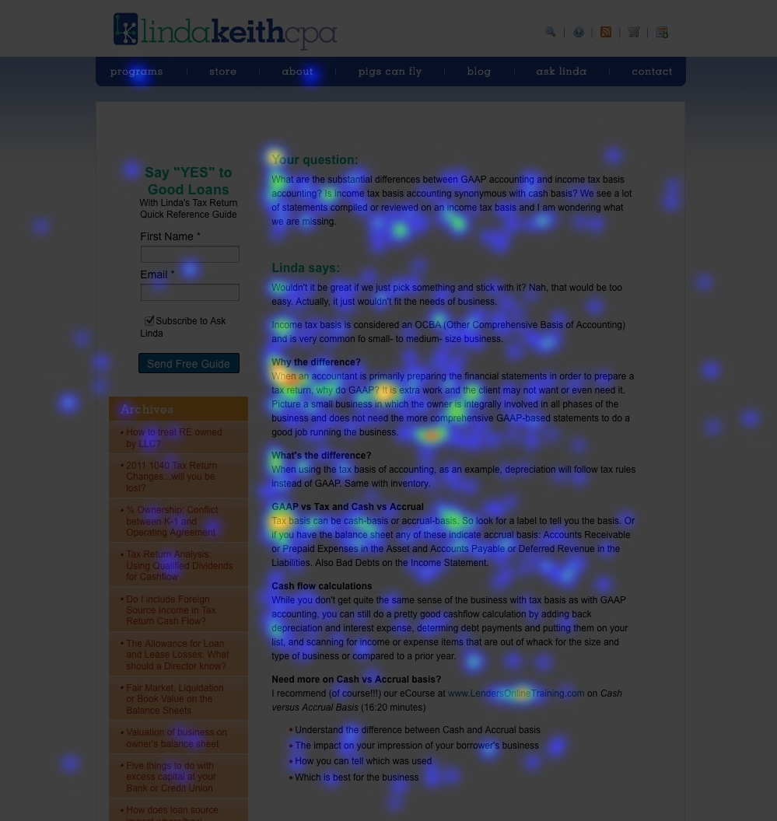

Slide 18
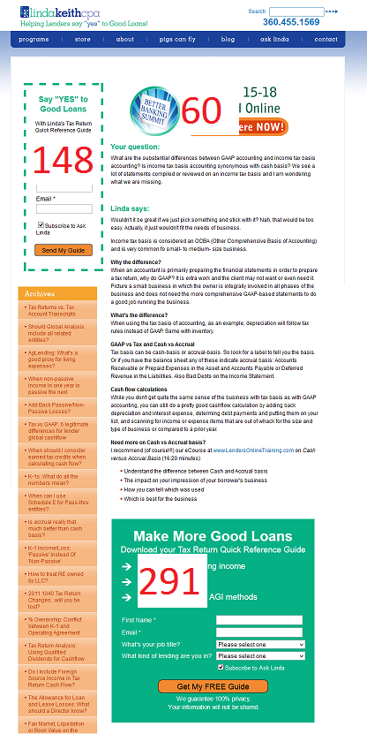

Slide 19
Ask questions

Slide 20
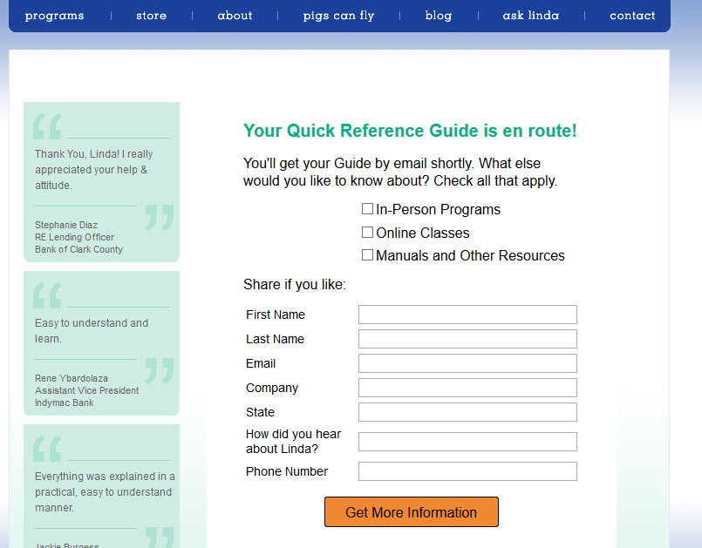

Slide 21
Gut Feel + Data = Good Marketing

Slide 22
www.redbeardconsulting.com/nsanw

Slide 23


Slide 24


Slide 25
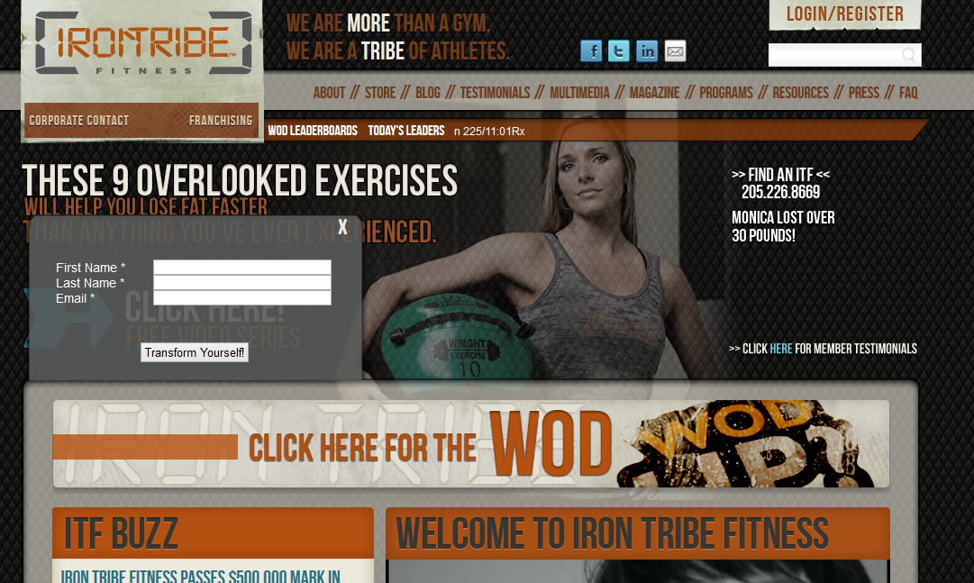

Slide 26
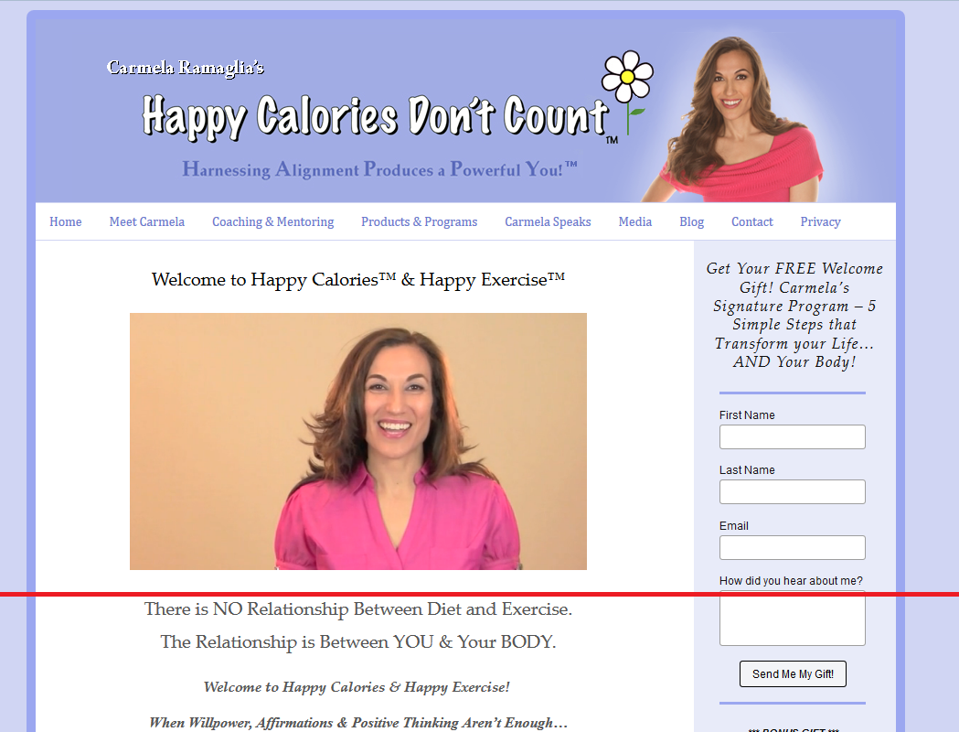

Slide 27
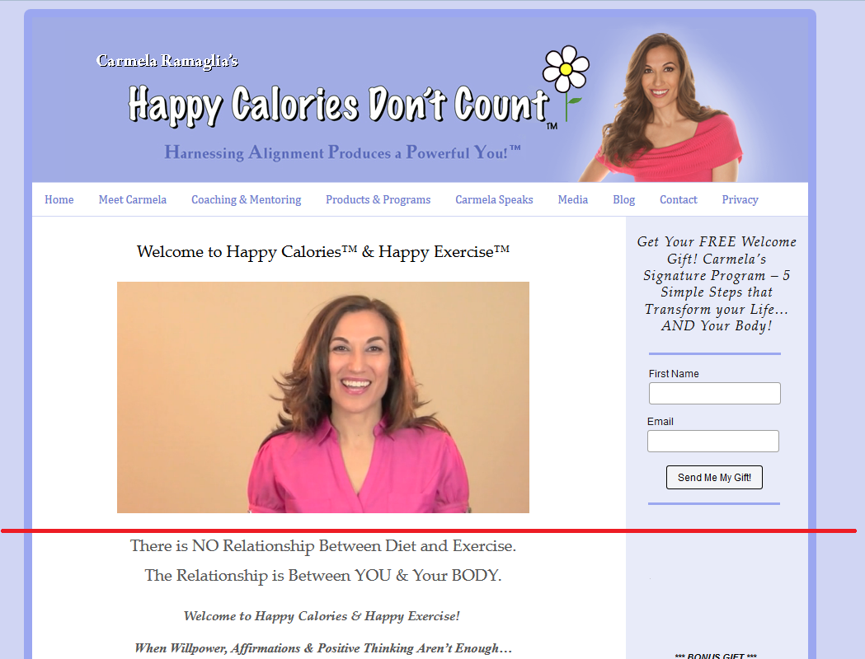

Slide 28
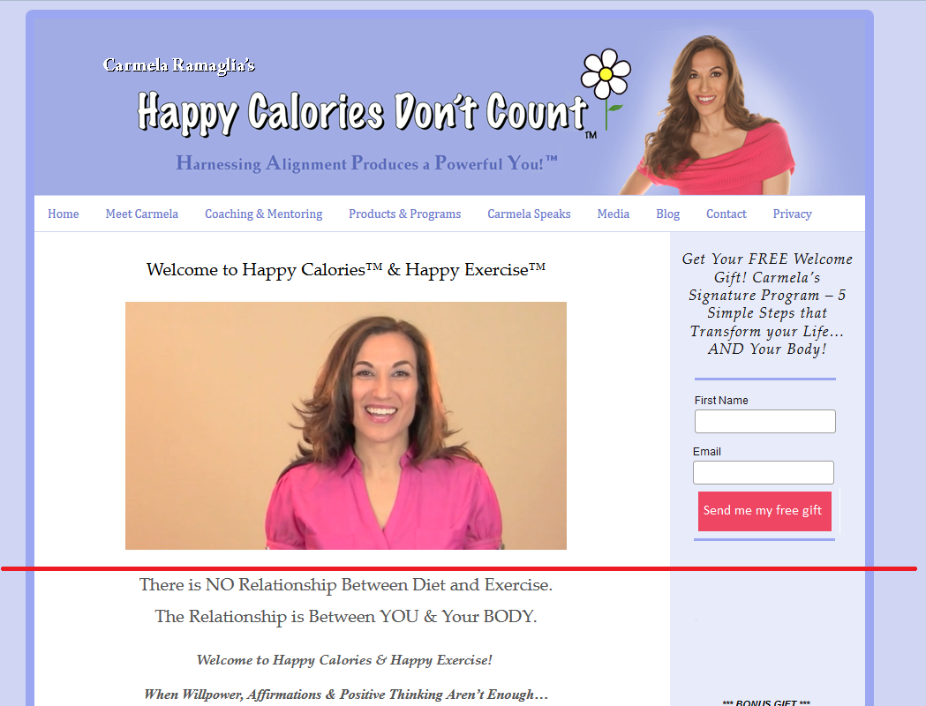

Slide 29
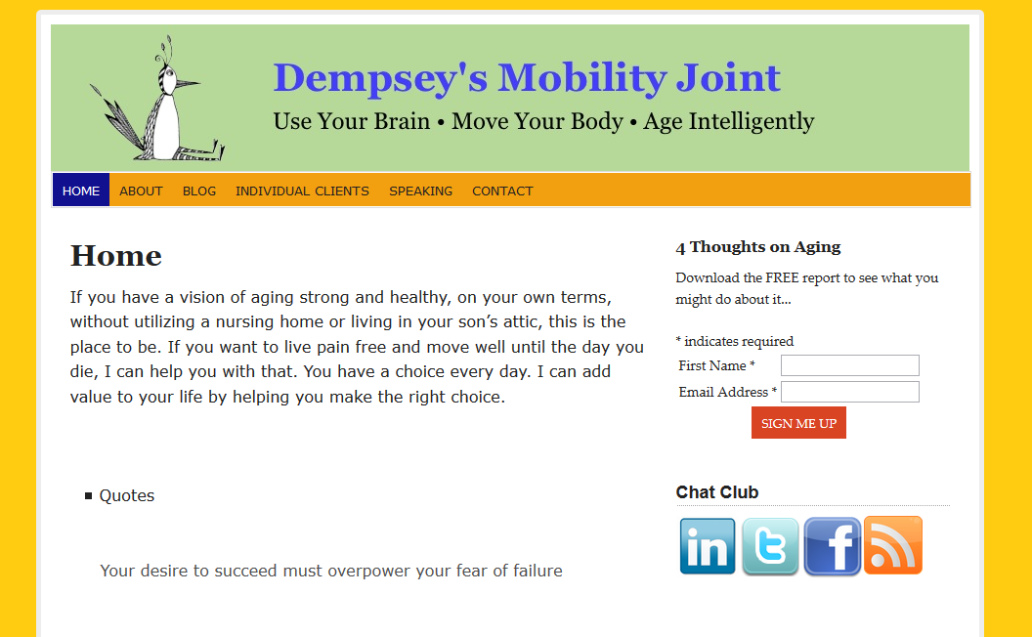

Slide 30

Send questions to brian@redbeardconsulting.com

